Slide 1

Variable Names

Slide 2
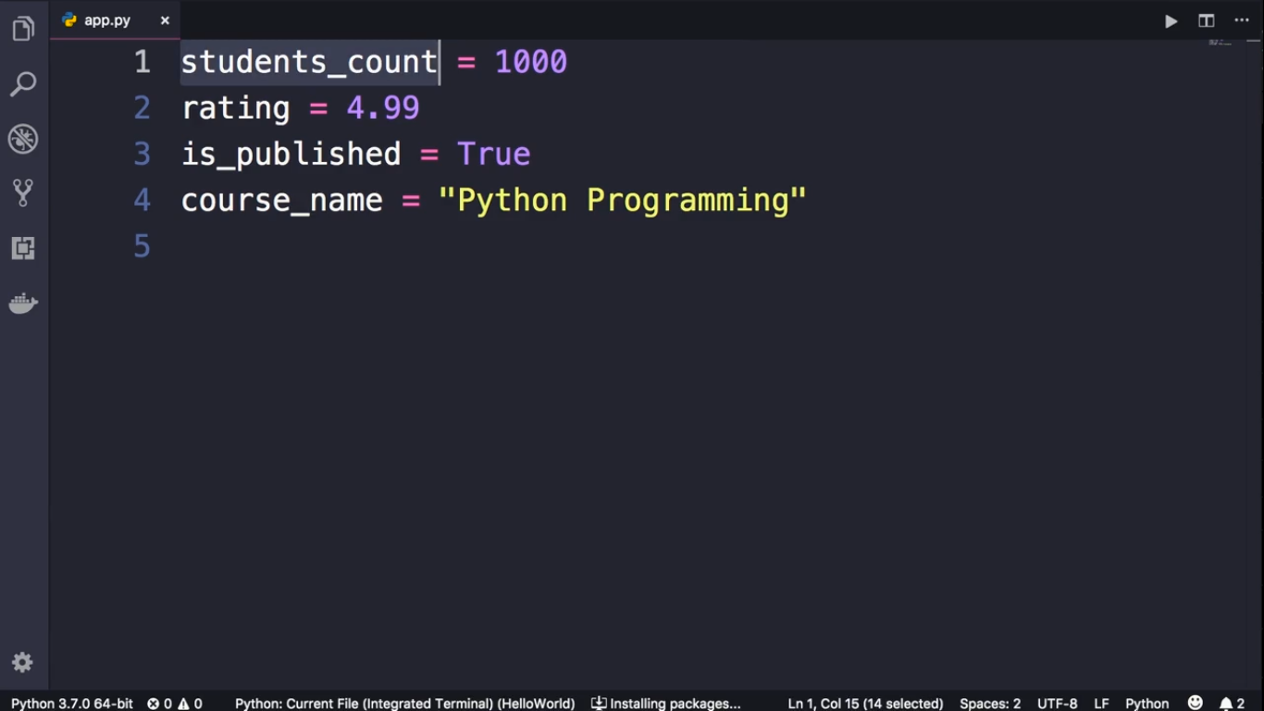
Variable Name should be descriptive and meaningful
Variable Name should be all lowercase
In a variable name, To Sperate multiple words You should use ‘_’ OR
You should use Camel Case like this ‘courseName’

Slide 3
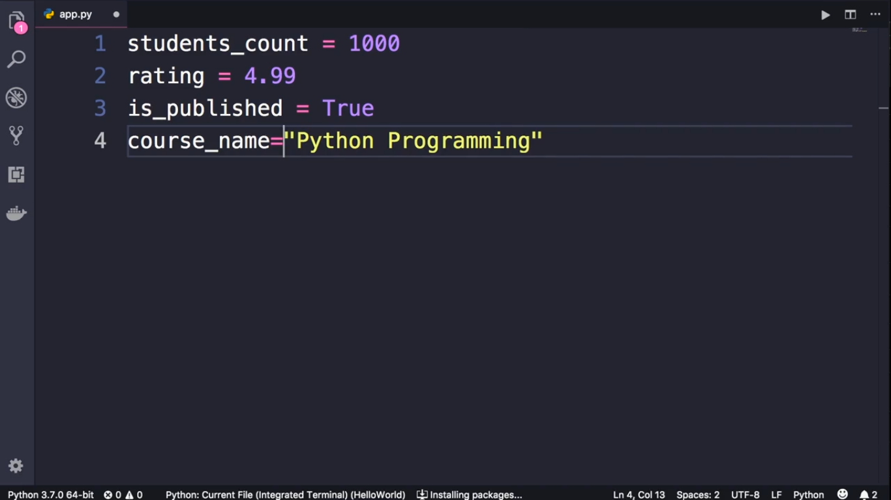
This line of code is dirty
It should be clean and beautiful

